Slide 1
Maria Montessori
Life and Work
– Helen Ramsdale

Slide 2
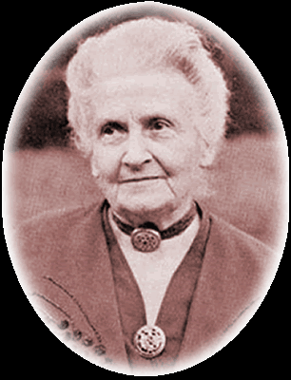
Who was Maria Montessori?
Maria Montessori (1870-1952) was an educator, scientist, physician, philosopher, feminist and humanitarian.
She overcame social and cultural obstacles to pursue her dream of becoming a doctor and she used science to reform education. She was the first early childhood educator to be given the honour of being nominated for the Nobel Peace Prize. She was nominated three times.

Slide 3
EARLY LIFE
Maria Montessori was born in Chiaravalle, Italy, on August 31st 1870, to Alessandro and Renilde Montessori. She was their only child.
Her family moved to Florence when she was 3 and then to Rome two years later because of her father’s job as an official in the Finance Ministry.
In keeping with her father’s socialist beliefs and the ‘rebirth’ of Italy, she started public elementary school at age 6.

Slide 4
SECONDARY SCHOOLING
At 13, Maria Montessori entered a secondary, technical school. Unusually for a woman, she was considering a future in engineering.
She received very good grades and high examination marks in her studies of accounting, algebra, arithmetic, geography, geometry, history, Italian, and sciences.
At 16, she continued to study. She completed her studies and did particularly well in all sciences and in mathematics.
When she graduated at the age of 20, she had earned a certificate in physics/mathematics and had decided to study medicine, against social and cultural norms. She questioned traditional methods and thinking.

Slide 5
A SETBACK… or two
Maria Montessori applied to enter medicine at the University of Rome, but was not accepted as a student.
Despite this setback, she enrolled in the University of Rome and completed a degree course in natural sciences. She excelled in her examinations in anatomy, botany, experimental physics, general and organic chemistry, histology, and zoology and graduated with a diploma di licenza in 1892.
This degree, along with additional studies in Italian and Latin, finally qualified her to enter the medical program at the University in 1893, where she was met with hostility and opposition, even harassment from male students.

Slide 6
IL DOTTORE
Through perseverance and determination, Maria Montessori overcame many difficulties (she was even required to perform her dissections of cadavers alone, after hours, as it was not deemed suitable for her to do this in the presence of men).
In her first year, Maria Montessori won an academic prize and in 1895 she secured a position as a hospital assistant, which enabled her to gain early clinical experience.
In her last two years she studied paediatrics and psychiatry, and worked in the paediatric consulting room and emergency service, which saw her become an acknowledged expert in paediatric medicine.

Slide 7
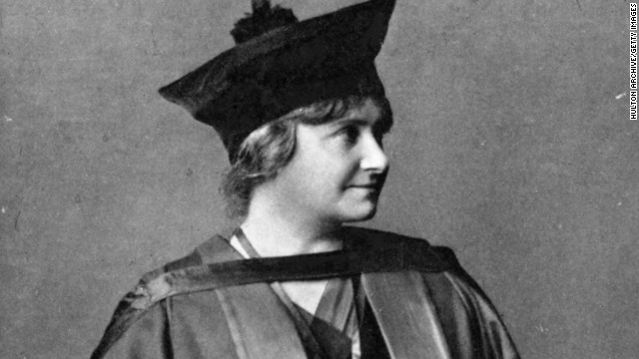
http://i2.cdn.turner.com/cnn/dam/assets/130508152638-lifeswork-maria-montessori-horizontal-gallery.jpg
Maria Montessori.

Slide 8
EARLY CAREER
In 1896, Maria Montessori graduated as a doctor of medicine. Her thesis was published in 1897 and applauded. She found employment as an assistant at the University hospital and started a private practice.
From 1896 to 1901, Montessori began working with and researching children labelled as "phrenasthenic" - children experiencing some form of mental retardation, illness, or disability. She did extensive clinical observations and became a professor of anthropology.
She began to travel, study, speak, and publish nationally and internationally on social justice. She became well known as a passionate advocate for women's rights and education, particularly for mentally disabled children.

Slide 9
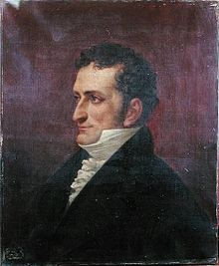
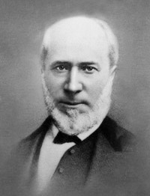
Montessori’s Mentors:
- Rosseau
- Pestazolli
- Froebel (kindergarten)
- Itard
- Seguin:
Jean Itard
(1812-1880)
Édouard Séguin
(1812-1880)

Slide 10
1901 Maria returned to the University of Rome for further studies, eventually earning an appointment as a lecturer in science and medicine in 1904.
In 1907 she opened the first Children's House, Casa dei Bambini at San Lorenzo, to look after children of working class families. This was the opportunity she had been waiting for and she spent the next few years developing and refining her educational philosophy and pedagogy.
She focused on observing and discovered that the children were focused, calm, learning, and respectful when able to interact with their environment and carry out purposeful work. She developed what is now known as the Montessori method and created many materials.
Through this work and her observations, she determined that the child is a noble human being…and man’s hope for peace.

Slide 11
Montessori’s Goals:
Stimulate the child’s natural love of learning
Provide a learning environment that nurtures
Provide a learning environment that is prepared, co-operative and respectful
Provide a learning environment that is sensorial
and consider the whole child
Provide an environment that encourages respect for self, others, and all life.

Slide 12
1909 Montessori opened her fourth Children's House, for victims of the Messina earthquake and held her first training course at Citta di Castello.
1910 Her book, The Montessori Method was published and in 1912 the first English translation was published.
Between 1913 - 1934 Dr. Montessori travelled to the U.S.A. and opened Montessori schools in Spain and Austria. She founded The Association Montessori Internationale (A.M.I) and held training courses in Britain and published her handbook.
But in 1934 Benito Mussolini closed all Montessori schools.
Maria Montessori left Italy to live in Spain.
In 1936 she left Spain to live in Holland.
In 1939 World War II broke out in Europe and 69 year old Maria and her son Mario left to work in India.

Slide 13
1939 -1946, Maria remained in India, unable to leave due to the war. On July 30th 1946 she returned to Amsterdam and a year later she returned to India for two years lecturing and touring, aged 76.
In 1948 she published two more books and between 1949 and 1951 she travelled all around Europe and to Pakistan, lecturing, running training courses, publishing more books and receiving three nominations for the Nobel Peace prize.
In 1952, at the age of 81, Dr, Maria Montessori passed away in her friends garden in Noordwijk aan Zee in Holland. She was buried in the local cemetery.
Maria Montessori left behind her an incredible legacy, an educational and lifestyle philosophy that has the potential to bring peace to all mankind and truly enable humans to reach their full potential.

Slide 14
REFERENCES:
http://en.wikipedia.org/wiki/Jean_Marc_Gaspard_Itard (Image)
http://en.wikipedia.org/wiki/%C3%89douard_S%C3%A9guin (Image)
http://en.wikipedia.org/wiki/Maria_Montessori#1901.E2.80.931906:_Further_studies (Image and text)
http://www.montessorieducationuk.org/?q=who-was-maria-montessori/maria-montessoris-time-line/maria-montessori-time-line
http://www.pathsoflearning.net/articles_Montessori.php
http://i2.cdn.turner.com/cnn/dam/assets/130508152638-lifeswork-maria-montessori-horizontal-gallery.jpg (Image)

